Slide 1
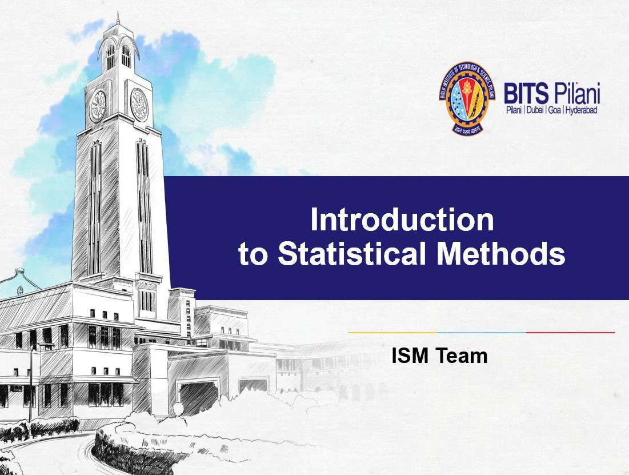


Slide 2


BITS Pilani
Sessions 14 Time Series Analysis (2nd Sep 2023)

Slide 3


Time Series

Slide 4

Statistical Methods for Data Science
Time Series Exponential Smoothing Techniques
Calculate the exponentially smoothed series F_{t} from the original time series Y_{t} as follows:
F₂ = Y₁
F₃ = αY₂ + (1 – α)F₂
F₄ = α Y₃ + (1 – α)F₃
F_{t+1} = α Y_{t} + (1 – α)F_{t}

Slide 5
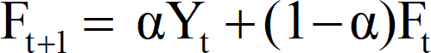
Statistical Methods for Data Science
Time Series Smoothing Techniques – Exponential
Exponential (Weighted average of all the past time series values with exponentially decreasing importance in the forecast)
where 𝐹_{𝑡} = 𝛼𝑌_{𝑡−1} + (1 − 𝛼)𝐹_{𝑡−1}
α=1 ⇒ Forecast value is just the previous actual value. A naïve forecast.
α=0 ⇒ Current Forecast value is just the previous forecast value.

Slide 6
α Y_{t} + (1 – α)F_{t}
 | Quar/Yr | Utilization(%) | F_{t} (α=0.2) | F_{t} (α=0.4) | F_{t} (α=0.7)
 | Q1/2017 | 82.50 | 82.50 | 82.50 | 82.50 | ^{F}t+1 ⁼
 | Q2/2017 | 81.30 | 82.50 | 82.50 | 82.50
 | Q3/2017 | 81.30 | 82.26 | 82.02 | 81.66
 | Q4/2017 | 79.00 | 82.07 | 81.73 | 81.41
 | Q1/2018 | 76.60 | 81.45 | 80.64 | 79.72
 | Q2/2018 | 78.00 | 80.48 | 79.02 | 77.54
 | Q3/2018 | 78.40 | 79.99 | 78.61 | 77.86
 | Q4/2018 | 78.00 | 79.67 | 78.53 | 78.24
 | Q1/2019 | 78.80 | 79.34 | 78.32 | 78.07
 | Q2/2019 | 78.70 | 79.23 | 78.51 | 78.58
 | Q3/2019 | 78.40 | 79.12 | 78.59 | 78.66
 | Q4/2019 | 80.00 | 78.98 | 78.51 | 78.48
 | Q1/2020 | 80.70 | 79.18 | 79.11 | 79.54
 | Q2/2020 | 80.70 | 79.69 | 80.14 | 81.05
 | Q3/2020 | 80.80 | 80.33 | 81.25 | 82.35
 | Q4/2006 |  | 80.23 | 81.05 | 82.04

Slide 7
Quar/Yr | Utilization(%) | F_{t} (α=0.1) | F_{t} (α=0.2) | F_{t} (α=0.3) | F_{t} (α=0.4) | F_{t} (α=0.5) | F_{t} (α=0.6) | F_{t} (α=0.7)
Q1/2017 | 82.50 | 82.50 | 82.50 | 82.50 | 82.50 | 82.50 | 82.50 | 82.50
Q2/2017 | 81.30 | 82.50 | 82.50 | 82.50 | 82.50 | 82.50 | 82.50 | 82.50
Q3/2017 | 81.30 | 82.38 | 82.26 | 82.14 | 82.02 | 81.90 | 81.78 | 81.66
Q4/2017 | 79.00 | 82.27 | 82.07 | 81.89 | 81.73 | 81.60 | 81.49 | 81.41
Q1/2018 | 76.60 | 81.94 | 81.45 | 81.02 | 80.64 | 80.30 | 80.00 | 79.72
Q2/2018 | 78.00 | 81.41 | 80.48 | 79.70 | 79.02 | 78.45 | 77.96 | 77.54
Q3/2018 | 78.40 | 81.07 | 79.99 | 79.19 | 78.61 | 78.23 | 77.98 | 77.86
Q4/2018 | 78.00 | 80.80 | 79.67 | 78.95 | 78.53 | 78.31 | 78.23 | 78.24
Q1/2019 | 78.80 | 80.52 | 79.34 | 78.67 | 78.32 | 78.16 | 78.09 | 78.07
Q2/2019 | 78.70 | 80.35 | 79.23 | 78.71 | 78.51 | 78.48 | 78.52 | 78.58
Q3/2019 | 78.40 | 80.18 | 79.12 | 78.70 | 78.59 | 78.59 | 78.63 | 78.66
Q4/2019 | 80.00 | 80.01 | 78.98 | 78.61 | 78.51 | 78.49 | 78.49 | 78.48
Q1/2020 | 80.70 | 80.01 | 79.18 | 79.03 | 79.11 | 79.25 | 79.40 | 79.54
Q2/2020 | 80.70 | 80.18 | 79.69 | 79.83 | 80.14 | 80.47 | 80.78 | 81.05
Q3/2020 | 80.80 | 80.45 | 80.33 | 80.75 | 81.25 | 81.69 | 82.05 | 82.35
Q4/2006 |  | 80.33 | 80.23 | 80.61 | 81.05 | 81.45 | 81.78 | 82.04
MSE |  | 6.36 | 4.76 | 3.94 | 3.41 | 3.07 | 2.85 | 2.71

Slide 8
Quar/Yr | Utilization(%) | F_{t} (α=0.8) | F_{t} (α=0.9)
Q1/2017 | 82.50 | 82.50 | 82.50
Q2/2017 | 81.30 | 82.50 | 82.50
Q3/2017 | 81.30 | 81.54 | 81.42
Q4/2017 | 79.00 | 81.35 | 81.31
Q1/2018 | 76.60 | 79.47 | 79.23
Q2/2018 | 78.00 | 77.17 | 76.86
Q3/2018 | 78.40 | 77.83 | 77.89
Q4/2018 | 78.00 | 78.29 | 78.35
Q1/2019 | 78.80 | 78.06 | 78.03
Q2/2019 | 78.70 | 78.65 | 78.72
Q3/2019 | 78.40 | 78.69 | 78.70
Q4/2019 | 80.00 | 78.46 | 78.43
Q1/2020 | 80.70 | 79.69 | 79.84
Q2/2020 | 80.70 | 81.30 | 81.51
Q3/2020 | 80.80 | 82.58 | 82.76
Q4/2006 |  | 82.25 | 82.42
MSE |  | 2.62 | 2.56

Slide 9
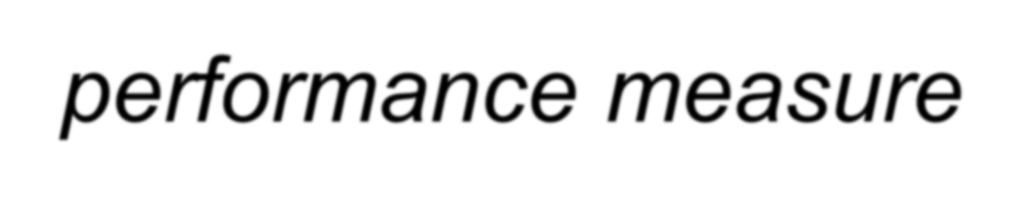
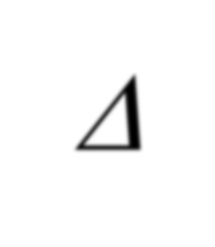

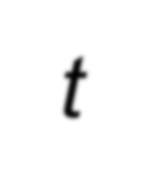
Statistical Methods for Data Science
Time Series Measurement of forecast error
To try to determine which one of these forecasting methods gives the “best” forecast, we evaluate the “success” of each method using a performance measure
Each performance measure begins by evaluating the forecast errors Δ_{t} for each time period t given by

Slide 10
Statistical Methods for Data Science
Time Series Measurement of forecast error
What was forecasted
to happen at time t using the forecast technique
Forecast Error
at time t
Δ _{t} = y_{t} - F_{t}
What actually happened
at time t

Slide 11




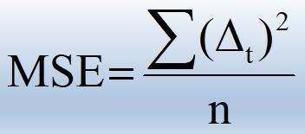
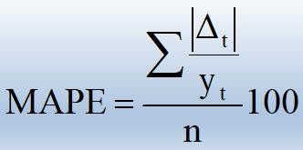




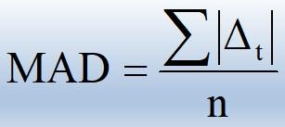
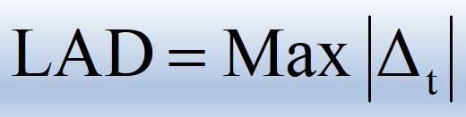
Statistical Methods for Data Science
Time Series Performance Measures
Mean Absolute Percent Error (MAPE)
Mean Square Error (MSE)
Mean Absolute Deviation (MAD)
Largest Absolute Deviation (LAD)

Slide 12
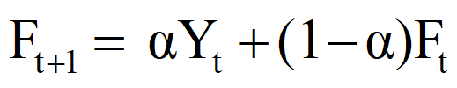
Quar/Yr | Utilization(%) | F_{t} (α=0.2) | F_{t} (α=0.4) | F_{t} (α=0.7)
Q1/2017 | 82.50 | 82.50 | 82.50 | 82.50
Q2/2017 | 81.30 | 82.50 | 82.50 | 82.50
Q3/2017 | 81.30 | 82.26 | 82.02 | 81.66
Q4/2017 | 79.00 | 82.07 | 81.73 | 81.41
Q1/2018 | 76.60 | 81.45 | 80.64 | 79.72
Q2/2018 | 78.00 | 80.48 | 79.02 | 77.54
Q3/2018 | 78.40 | 79.99 | 78.61 | 77.86
Q4/2018 | 78.00 | 79.67 | 78.53 | 78.24
Q1/2019 | 78.80 | 79.34 | 78.32 | 78.07
Q2/2019 | 78.70 | 79.23 | 78.51 | 78.58
Q3/2019 | 78.40 | 79.12 | 78.59 | 78.66
Q4/2019 | 80.00 | 78.98 | 78.51 | 78.48
Q1/2020 | 80.70 | 79.18 | 79.11 | 79.54
Q2/2020 | 80.70 | 79.69 | 80.14 | 81.05
Q3/2020 | 80.80 | 80.33 | 81.25 | 82.35
Q4/2006 |  | 80.23 | 81.05 | 82.04
MSE |  | 4.76 | 3.41 | 2.71
Done the analysis on the previous problem for 3 different values of α
For α=0.7, it is better
The exponential smoothing does not have a significant initial delay like the Moving Av. where the initial k values are not smoothed
Formula can be rearranged as

Slide 13
Statistical Methods for Data Science
Time Series Exponential Smoothing Techniques
1. Select an exponential smoothing constant, α, between 0 and 1. Remember that small values of α give less weight to the current value of the series and yield a smoother series. Larger choices of α assign more weight to the current value of the series and yield a more variable series.

Slide 14
Statistical Methods for Data Science
Time Series Smoothing Techniques – Exponential
Done the analysis on the previous problem for 3 different values of α
For α=0.7, it is better
The exponential smoothing does not have a significant initial delay like the Moving Av. where the initial k values are not smoothed
Formula can be rearranged as
Quarter/ Year | Utilization (%) | F_{t} (α=0.2) | F_{t} (α=0.4) | F_{t} (α=0.7)
Q1/2017 | 82.50
Q2/2017 | 81.30 | 82.5 | 82.5 | 82.5
Q3/2017 | 81.30 | 82.26 | 82.02 | 81.66
Q4/2017 | 79.00 | 81.61 | 80.81 | 79.80
Q1/2018 | 76.60 | 80.61 | 79.13 | 77.56
Q2/2018 | 78.00 | 80.09 | 78.68 | 77.87
Q3/2018 | 78.40 | 79.75 | 78.57 | 78.24
Q4/2018 | 78.00 | 79.40 | 78.34 | 78.07
Q1/2019 | 78.80 | 79.28 | 78.52 | 78.58
Q2/2019 | 78.70 | 79.16 | 78.59 | 78.66
Q3/2019 | 78.40 | 79.01 | 78.52 | 78.48
Q4/2019 | 80.00 | 79.21 | 79.11 | 79.54
Q1/2020 | 80.70 | 79.51 | 79.75 | 80.35
Q2/2020 | 80.70 | 79.75 | 80.13 | 80.60
Q3/2020 | 80.80 | 79.96 | 80.40 | 80.74
 | MSE | 2.70 | 1.04 | 0.26

Slide 15
 | Quar/Yr | Utilization (%) | F_{t} (α=0.2) | ∆_{t}²(α=0.2)
Δ _{t} = Y_{t} - F_{t} | Q1/2017 | 82.50 | 82.50 | 0.00
 | Q2/2017 | 81.30 | 82.26 | 0.92
 | Q3/2017 | 81.30 | 82.07 | 0.59
 | Q4/2017 | 79.00 | 81.45 | 6.00
 | Q1/2018 | 76.60 | 80.48 | 15.05
 | Q2/2018 | 78.00 | 79.99 | 3.96
 | Q3/2018 | 78.40 | 79.67 | 1.61
 | Q4/2018 | 78.00 | 79.34 | 1.80
 | Q1/2019 | 78.80 | 79.23 | 0.18
 | Q2/2019 | 78.70 | 79.12 | 0.18
 | Q3/2019 | 78.40 | 78.98 | 0.34
 | Q4/2019 | 80.00 | 79.18 | 0.67
 | Q1/2020 | 80.70 | 79.49 | 1.46
 | Q2/2020 | 80.70 | 79.73 | 0.94
 | Q3/2020 | 80.80 | 79.94 | 0.74
 |  | MSE |  | 2.297

Slide 16
 | Quar/Yr | Utilization (%) | F_{t} (α=0.4) | ∆_{t}²(α=0.4)
Δ _{t} = Y_{t} - F_{t} | Q1/2017 | 82.50 | 82.5 | 0.00
 | Q2/2017 | 81.30 | 82.02 | 0.52
 | Q3/2017 | 81.30 | 81.73 | 0.18
 | Q4/2017 | 79.00 | 80.64 | 2.69
 | Q1/2018 | 76.60 | 79.02 | 5.86
 | Q2/2018 | 78.00 | 78.61 | 0.37
 | Q3/2018 | 78.40 | 78.53 | 0.02
 | Q4/2018 | 78.00 | 78.32 | 0.10
 | Q1/2019 | 78.80 | 78.51 | 0.08
 | Q2/2019 | 78.70 | 78.59 | 0.01
 | Q3/2019 | 78.40 | 78.51 | 0.01
 | Q4/2019 | 80.00 | 79.11 | 0.79
 | Q1/2020 | 80.70 | 79.74 | 0.92
 | Q2/2020 | 80.70 | 80.13 | 0.32
 | Q3/2020 | 80.80 | 80.4 | 0.16
 |  | MSE |  | 0.803

Slide 17
 | Quar/Yr | Utilization (%) | F_{t} (α=0.7) | ∆_{t}²(α=0.7)
Δ _{t} = Y_{t} - F_{t} | Q1/2017 | 82.50 | 82.50 | 0.00
 | Q2/2017 | 81.30 | 81.66 | 0.13
 | Q3/2017 | 81.30 | 81.41 | 0.01
 | Q4/2017 | 79.00 | 79.72 | 0.52
 | Q1/2018 | 76.60 | 77.54 | 0.88
 | Q2/2018 | 78.00 | 77.86 | 0.02
 | Q3/2018 | 78.40 | 78.24 | 0.03
 | Q4/2018 | 78.00 | 78.07 | 0.00
 | Q1/2019 | 78.80 | 78.58 | 0.05
 | Q2/2019 | 78.70 | 78.66 | 0.00
 | Q3/2019 | 78.40 | 78.48 | 0.01
 | Q4/2019 | 80.00 | 79.54 | 0.21
 | Q1/2020 | 80.70 | 80.35 | 0.12
 | Q2/2020 | 80.70 | 80.6 | 0.01
 | Q3/2020 | 80.80 | 80.74 | 0.00
 |  | MSE |  | 0.133

Slide 18
Statistical Methods for Data Science
Time Series Exponential Smoothing Techniques
Done the analysis on the previous problem for 3 different values of α
For α=0.7, it is better
The exponential smoothing does not have a significant initial delay like the Moving Average, where the initial k values are not smoothed
Formula can be rearranged as
Quarter/ Year | Utilization (%) | F_{t} (α=0.2) | F_{t} (α=0.4) | F_{t} (α=0.7)
Q1/2017
Q2/2017 | 81.30 | 82.26 | 82.02 | 81.66
Q3/2017 | 81.30 | 82.07 | 81.73 | 81.41
Q4/2017 | 79.00 | 81.45 | 80.64 | 79.72
Q1/2018 | 76.60 | 80.48 | 79.02 | 77.54
Q2/2018 | 78.00 | 79.99 | 78.61 | 77.86
Q3/2018 | 78.40 | 79.67 | 78.53 | 78.24
Q4/2018 | 78.00 | 79.34 | 78.32 | 78.07
Q1/2019 | 78.80 | 79.23 | 78.51 | 78.58
Q2/2019 | 78.70 | 79.12 | 78.59 | 78.66
Q3/2019 | 78.40 | 78.98 | 78.51 | 78.48
Q4/2019 | 80.00 | 79.18 | 79.11 | 79.54
Q1/2020 | 80.70 | 79.49 | 79.74 | 80.35
Q2/2020 | 80.70 | 79.73 | 80.13 | 80.60
Q3/2020 | 80.80 | 79.94 | 80.40 | 80.74
 | MSE | 2.30 | 0.80 | 0.13
𝐹 = 𝛼𝑌_{𝑡} + (1 − 𝛼)𝐹_{𝑡}
𝑡+1

Slide 19
Statistical Methods for Data Science
Time Series Smoothing Techniques – Moving Averages
The Moving Average basically filters out rapid fluctuations .i.e. high frequency noise. Thus it acts as a low-pass filter.
We can choose the index of the MA filter by trial and error. Comparing the Forecast Accuracy for index selection.
For our eg., we find that MSE for the 2-Qtr filter is better
 | Quarter/Year | Utilization (%) | 2-Qtr MA | 3-Qtr MA | 4-Qtr MA
 | 1/2003 | 82.50
 | 2/2003 | 81.30 | 81.90 | 81.70
 | 3/2003 | 81.30 | 81.30 | 80.53
 | 4/2003 | 79.00 | 80.15 | 78.97 | 81.03
 | 1/2004 | 76.60 | 77.80 | 77.87 | 79.55
 | 2/2004 | 78.00 | 77.30 | 77.67 | 78.73
 | 3/2004 | 78.40 | 78.20 | 78.13 | 78.00
 | 4/2004 | 78.00 | 78.20 | 78.40 | 77.75
 | 1/2005 | 78.80 | 78.40 | 78.50 | 78.30
 | 2/2005 | 78.70 | 78.75 | 78.63 | 78.48
 | 3/2005 | 78.40 | 78.55 | 79.03 | 78.48
 | 4/2005 | 80.00 | 79.20 | 79.70 | 78.98
 | 1/2006 | 80.70 | 80.35 | 80.47 | 79.45
 | 2/2006 | 80.70 | 80.70 | 80.73 | 79.95
 | 3/2006 | 80.80 | 80.75 |  | 80.55
 |  | MSE | 0.33 | 0.84 | 1.42

Slide 20
Statistical Methods for Data Science
Time Series Smoothing Techniques – Moving Averages
The Moving Average basically filters out rapid fluctuations .i.e. high frequency noise. Thus it acts as a low-pass filter.
We can choose the index of the MA filter by trial and error. Comparing the Forecast Accuracy for index selection.
For our eg., we find that MSE for the 2-Qtr filter is better
 | Quarter/Year | Utilization (%) | 2-Qtr MA | 3-Qtr MA | 4-Qtr MA
 | Q1/2017 | 82.50
 | Q2/2017 | 81.30 | 81.90 | 81.70
 | Q3/2017 | 81.30 | 81.30 | 80.53
 | Q4/2017 | 79.00 | 80.15 | 78.97 | 81.03
 | Q1/2018 | 76.60 | 77.80 | 77.87 | 79.55
 | Q2/2018 | 78.00 | 77.30 | 77.67 | 78.73
 | Q3/2018 | 78.40 | 78.20 | 78.13 | 78.00
 | Q4/2018 | 78.00 | 78.20 | 78.40 | 77.75
 | Q1/2019 | 78.80 | 78.40 | 78.50 | 78.30
 | Q2/2019 | 78.70 | 78.75 | 78.63 | 78.48
 | Q3/2019 | 78.40 | 78.55 | 79.03 | 78.48
 | Q4/2019 | 80.00 | 79.20 | 79.70 | 78.98
 | Q1/2020 | 80.70 | 80.35 | 80.47 | 79.45
 | Q2/2020 | 80.70 | 80.70 | 80.73 | 79.95
 | Q3/2020 | 80.80 | 80.75 |  | 80.55
 |  | MSE | 0.33 | 0.84 | 1.42

Slide 21







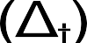



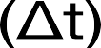
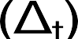
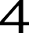



























































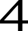



























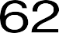




















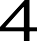






























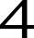



















































































































































































































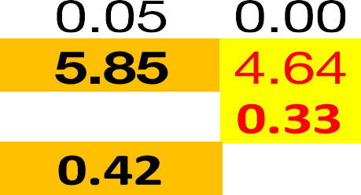
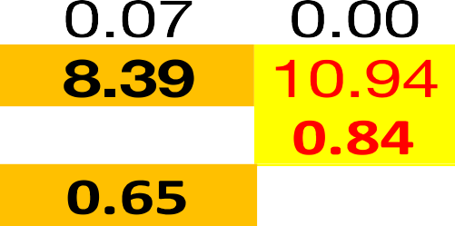




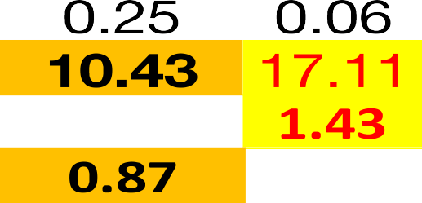





Statistical Methods for Data Science
Time Series Smoothing Techniques – Moving Averages

Slide 22
Statistical Methods for Data Science
Time Series Which performance should be used?
Choice of the modeler
Advantages
MSE gives greater weight to larger deviations (which could result from outliers)
MAD gives less weight to larger deviations
MAPE gives less overall weight to a large deviation if the time series value is large
LAD tells us if all deviations fall below some threshold value
Although we illustrate all 4 techniques, in general focus will be on MSE and MAD.

Slide 23




























































































































































































































































































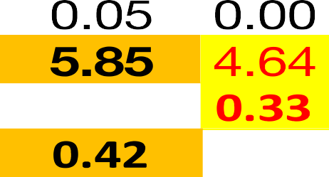










Statistical Methods for Data Science
Time Series Smoothing Techniques – Moving Averages

Slide 24
Statistical Methods for Data Science
Time Series Smoothing Techniques – Exponential
Objective is to estimate the overall time series as a combination of long term trend and seasonality
Additive Model: X_{t} = F_{t} + S_{t} + ɛ_{t}
Multiplicative Model: X_{t} = F_{t} x S_{t} x ɛ_{t}
Multiplicative model can be converted to additive model by taking log. Other models are also possible
The trend and seasonality can be decomposed using smoothing and regression methods
Exponential smoothing is suitable with constant variance and no seasonality. Recommended for short-term forecast.
Another method for stationarizing the time series is by doing transformation .eg. Differencing

Slide 25
Statistical Methods for Data Science
Time Series
Holt Double Exponential Smoothing Technique
⋇ The simple exponential smoothing forecast is a weighted sum of actual value with 𝖺 and the forecast for the same period with (1-𝖺). At 𝖺 =1, it is identical to the naïve forecast.
⋇ However the simple exponential smoothing forecasts lag the actual time series values when the time series has a trend.
⋇ The trend makes it difficult for forecast to ‘keep up’ since there is no account of changes in level from period to
period.
⋇ The Holt double exponential smoothing method adds the ability to account for the trend component the time series in

Slide 26
Statistical Methods for Data Science
Time Series
Holt Double Exponential Smoothing Technique
⋇ Holt double exponential is a simple exponential smoothing with a added trend components that helps fix the lag issues
⋇ Weights are used to smooth the level and trend.
⋇ Holt smoothed value calculation for the level is exactly same calculation as in simple exponential smoothing
⋇ The trend component is a weighted difference between the current smoothed level and the prior period smoothed level
plus prior trend.
⋇ Finally, the Holt double exponential smoothing forecast for the next period is a sum of smoothed level and smoothed

Slide 27
Statistical Methods for Data Science
Time Series
Holt Double Exponential Smoothing Technique
Y_{t}
^{L}t-1 ^{+ T}t-1
Prior forecast level
1-𝛼
Current smooth level
L_{t}
+
Current
+
actual level
𝛼
Forecast value
F_{t+1}=L_{t}+T_{t}
^{L}t ^{- L}t-1
Current
smoothed level – Prior smoothed level
𝛽
^{T}t-1
+
Prior smoothed trend
Current smooth trend
T
1-𝛽
t

Slide 28
Statistical Methods for Data Science
Time Series
Holt Double Exponential Smoothing Technique
Current smoothed level: 𝐿_{𝑡} = 𝑎𝑌_{𝑡} +
1 − 𝑎 (𝐿_{𝑡−1} + 𝑇_{𝑡−1})
Current smoothed Trend: 𝑇_{𝑡} = 𝛽(𝐿_{𝑡} − 𝐿_{𝑡−1}) +
1 − 𝛽
^{𝑇}𝑡−1
Forecast next period:
𝐹_{𝑡+1} = 𝐿_{𝑡} + 𝑇_{𝑡}
𝐹_{𝑡+k} = 𝐿_{𝑡} + 𝑘𝑇_{𝑡}
Forecast next k period:
0 ≤ 𝑎 ≤1
0 ≤ 𝛽 ≤1
Level smoothing factor:
Level smoothing factor:

Slide 29
Statistical Methods for Data Science
Time Series
Holt Double Exponential Smoothing Technique
Current smoothed level: 𝐿_{𝑡} = 𝑎𝑌_{𝑡} +
1 − 𝑎 (𝐿_{𝑡−1} + 𝑇_{𝑡−1})
Level smoothing constant
Current data value
Prior period smoothed level
Prior period smoothed trend
Simple exponential smoothing

Slide 30
Statistical Methods for Data Science
Time Series
Holt Double Exponential Smoothing Technique
When 𝑎 = 0
𝐿_{𝑡} = (𝟎)𝑌_{𝑡} + 1 − (𝟎) (𝐿_{𝑡−1} + 𝑇_{𝑡−1})
^{𝐿}𝑡 ^{= 𝐿}𝑡−1 ^{+ 𝑇}𝑡−1
𝐿_{𝑡} = 𝐹_{𝑡}
Smoothed level = Current forecast

Slide 31
Statistical Methods for Data Science
Time Series
Holt Double Exponential Smoothing Technique
When 𝑎 = 1
𝐿_{𝑡} = (𝟏)𝑌_{𝑡} + 1 − (𝟏) (𝐿_{𝑡−1} + 𝑇_{𝑡−1})
𝐿_{𝑡} = 𝑌_{𝑡}
Smoothed level = Current actual level of the data

Slide 32
Statistical Methods for Data Science
Time Series
Holt Double Exponential Smoothing Technique
Current smoothed trend: 𝑇_{𝑡} = 𝛽(𝐿_{𝑡} − 𝐿_{𝑡−1}) +
1 − 𝛽 𝑇_{𝑡−1}
Trend smoothing constant
Current smoothed level
Prior period smoothed level
Prior period smoothed trend

Slide 33
Statistical Methods for Data Science
Time Series
Holt Double Exponential Smoothing Technique
𝑇_{𝑡} = 𝛽(𝐿_{𝑡} − 𝐿_{𝑡−1}) + 1 − 𝛽 𝑇_{𝑡−1}
𝑇_{𝑡} = (𝟎)(𝐿_{𝑡} − 𝐿_{𝑡−1}) + 1 − (0) 𝑇_{𝑡−1}
^{𝑇}𝑡 ^{= 𝑇}𝑡−1
When 𝛽= 0
Smoothed trend = Trend from the last period

Slide 34
Statistical Methods for Data Science
Time Series
Holt Double Exponential Smoothing Technique
When 𝛽= 1
𝑇_{𝑡} = 𝛽(𝐿_{𝑡} − 𝐿_{𝑡−1}) + 1 − 𝛽 𝑇_{𝑡−1}
𝑇_{𝑡} = (1)(𝐿_{𝑡} − 𝐿_{𝑡−1}) + 1 − (𝟏) 𝑇_{𝑡−1}
𝑇_{𝑡} = 𝐿_{𝑡} − 𝐿_{𝑡−1}
Current smoothed trend = Current smoothed level – prior smoothed level

Slide 35
Statistical Methods for Data Science
Time Series
Holt Double Exponential Smoothing Technique
Level smoothing constant (𝑎)
0
1
Forecast all the same (flat line) of Y_{t} | Smoothed level is the same as actual level. Trend is the full difference between smoothed level
Forecast all the same (flat line) of Y_{t} | Same as Naïve fore cast, no trend component
Trend smoothing
constant (𝛽)
1
0

Slide 36
Statistical Methods for Data Science
Time Series
Holt Double Exponential Smoothing Technique
Level smoothing constant (𝑎)
0
1
Actual Forecast
Actual Forecast
Trend smoothing
constant (𝛽)
1
0

Slide 37
Statistical Methods for Data Science
Time Series
Holt Double Exponential Smoothing Technique
Example: Year & GDP
Year | 2000 | 2001 | 2002 | 2003 | 2004 | 2005 | 2006 | 2007 | 2008 | 2009 | 2010
GDP | 1451 | 1499 | 1686 | 1764 | 1879 | 1948 | 2013 | 2090 | 2173 | 2286 | 2404
Year | 2011 | 2012 | 2013 | 2014 | 2015 | 2016 | 2017 | 2018 | 2019 | 2020
GDP | 2465 | 2501 | 2597 | 2689 | 2688 | 2576 | 2530 | 2513 | 2503 | 2396

Slide 38
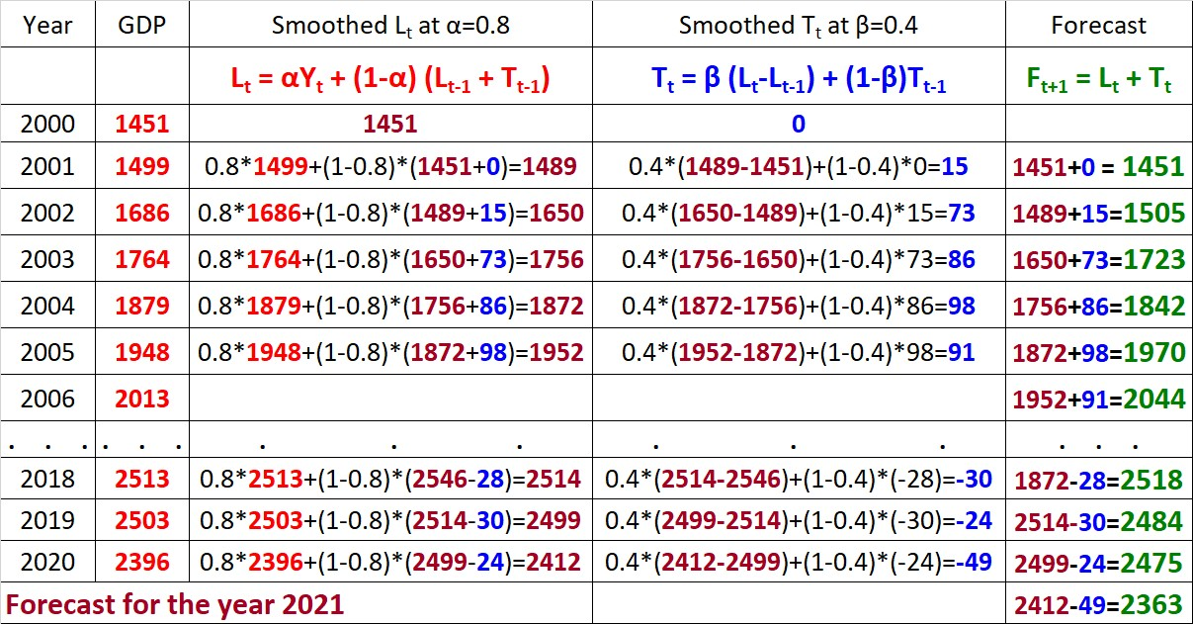
Statistical Methods for Data Science
Time Series
Holt Double Exponential Smoothing Technique
Example: Year & GDP

Slide 39
Statistical Methods for Data Science
Time Series Holts-Winters Triple Exponential Smoothing
Steps in calculation
M: No. of periods/ year (Quarterly (M=4), Monthly (M=12))
Initial seasonal factors:
𝒀_{𝟏}
𝒀_{𝟐}
𝑺_{𝟏} =
,
𝑺 =
,
𝑨𝒗𝒆𝒓𝒂𝒈𝒆 (𝒀_{𝟏}, 𝒀_{𝟐}, … , 𝒀_{𝑴})
𝟐
𝑨𝒗𝒆𝒓𝒂𝒈𝒆 (𝒀_{𝟏}, 𝒀_{𝟐}, … , 𝒀_{𝑴})
.
𝑺 =
.
.
𝒀_{𝑴}
𝑴
𝑨𝒗𝒆𝒓𝒂𝒈𝒆 (𝒀_{𝟏}, 𝒀_{𝟐}, … , 𝒀_{𝑴})

Slide 40
Statistical Methods for Data Science
Time Series Holts-Winters Triple Exponential Smoothing
Steps in calculation
M: No. of periods/ year (Quarterly (M=4), Monthly (M=12))
Initial level:
^{𝒀}𝟏𝟑
𝑳 =
𝟏𝟑
𝑺_{𝟏}
Initial trend:
^{𝒀}𝟏𝟑 ^{𝒀}𝟏𝟐
𝑻 = −
𝟏𝟑
𝑺_{𝟏}
^{𝑺}𝟏𝟐

Slide 41
Statistical Methods for Data Science
Time Series Holts-Winters Triple Exponential Smoothing
Level formula
Forecast
𝒀_{𝒕}
𝑳_{𝒕} + 𝑻_{𝒕}
^{𝑭}𝒕+𝟏 ⁼
^{𝑺}𝒕−𝑴+𝟏
𝑳_{𝒕} = 𝑎 + (𝟏 − 𝑎)(𝑳
+𝑻 )
𝒕−𝟏
𝒕−𝟏
^{𝑺}𝒕−𝑴
Trend formula
𝑻_{𝒕} = 𝖰 𝑳_{𝒕} + 𝑳_{𝒕−𝟏} + (𝟏 − 𝖰)𝑻_{𝒕−𝟏}
Seasonal factor formula
𝒀_{𝒕}
𝑺 = + (𝟏 − )𝑺
𝒕
𝑳_{𝒕}
𝒕−𝑴

Slide 42
Statistical Methods for Data Science
Time Series Holts-Winters Triple Exponential Smoothing
Example on demand data
Period | 1 | 2 | 3 | 4 | 5 | 6 | 7 | 8 | 9 | 10 | 11 | 12 | 13 | 14
Year | 2011 | 2011 | 2011 | 2011 | 2012 | 2012 | 2012 | 2012 | 2013 | 2013 | 2013 | 2013 | 2014 | 2014
Quarter | 1 | 2 | 3 | 4 | 1 | 2 | 3 | 4 | 1 | 2 | 3 | 4 | 1 | 2
Demand | 362 | 385 | 432 | 341 | 382 | 409 | 498 | 387 | 473 | 513 | 582 | 474 | 544 | 582
Period | 15 | 16 | 17 | 18 | 19 | 20 | 21 | 22 | 23 | 24 | 25 | 26 | 27 | 28
Year | 2014 | 2014 | 2015 | 2015 | 2015 | 2015 | 2016 | 2016 | 2016 | 2016
Quarter | 3 | 4 | 1 | 2 | 3 | 4 | 1 | 2 | 3 | 4 | 1 | 2 | 3 | 4
Demand | 681 | 557 | 628 | 707 | 773 | 592 | 627 | 725 | 854 | 661

Slide 43
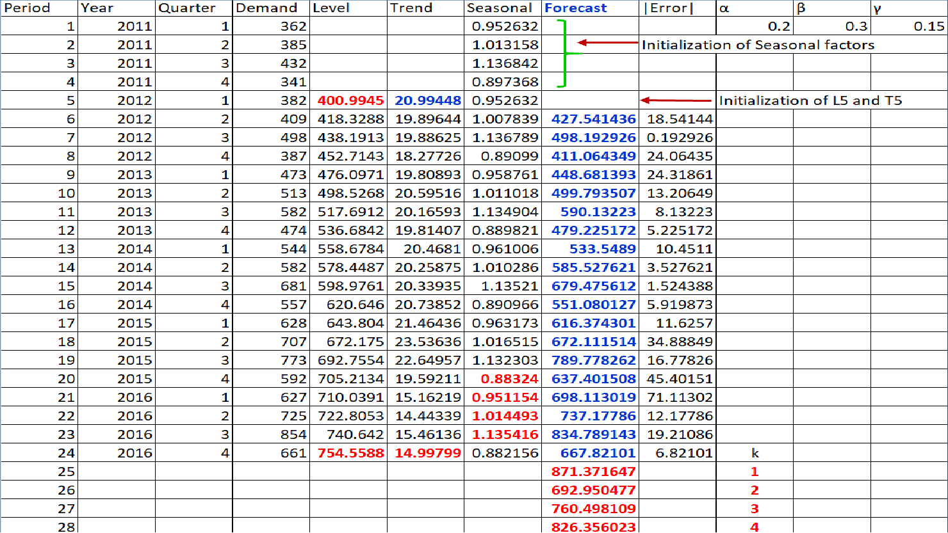

Slide 44
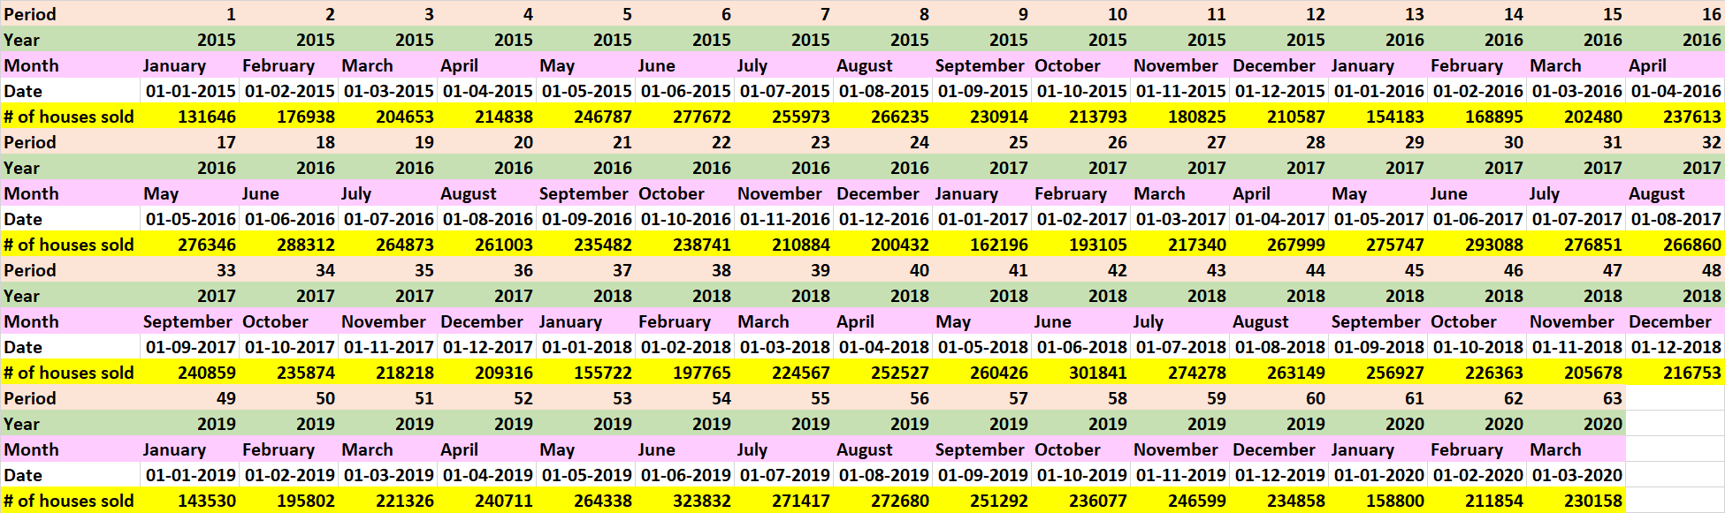
Example on seasonal sale of houses

Slide 45
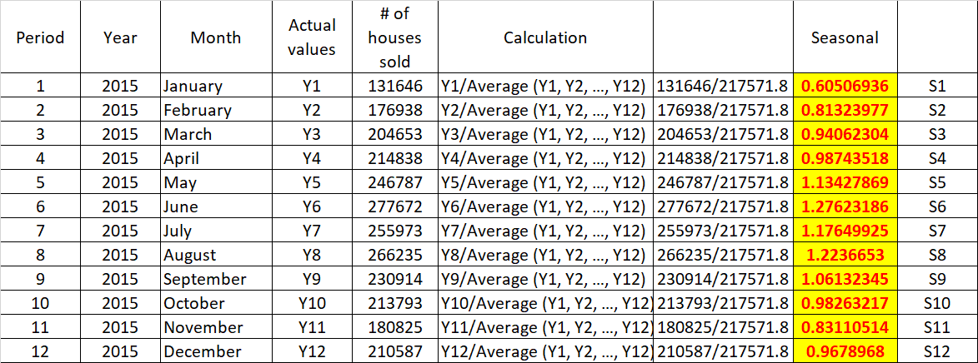

Slide 46
Statistical Methods for Data Science
Time Series Holts-Winters Triple Exponential Smoothing
Level | Seasonal
S1 | 0.605069
S2 | 0.81324
S3 | 0.940623
S4 | 0.987435
S5 | 1.134279
S6 | 1.276232
S7 | 1.176499
S8 | 1.223665
S9 | 1.061323
S10 | 0.982632
S11 | 0.831105
S12 | 0.967897
Period | Year | Month | # of houses | Level | Trend | Seasonal | Forecast | Error
12 | 2015 | December | 210587
13 | 2016 | January | 154183 | 254819 | 37247 | 0.605069
14 | 2016 | February | 168895 | 283627 | 36403 | 0.791464 | 237519 | -68624
^{𝒀}𝟏𝟑
𝑳 = =
𝟏𝟓𝟒𝟏𝟖𝟑
= 𝟐𝟓𝟒𝟖𝟏𝟗
𝟏𝟑
𝑺_{𝟏}
^{𝒀}𝟏𝟑
𝟎. 𝟔𝟎𝟓𝟎𝟔𝟗
^{𝒀}𝟏𝟐
𝟏𝟓𝟒𝟏𝟖𝟑 𝟐𝟏𝟎𝟓𝟖𝟕
= − = 𝟑𝟕𝟐𝟒𝟕
𝟎. 𝟔𝟎𝟓𝟎𝟔𝟗 𝟎. 𝟗𝟔𝟕𝟖𝟗𝟕
𝑻_{𝟏𝟑} =
−
𝑺
𝑺
𝟏
𝟏𝟐

Slide 47
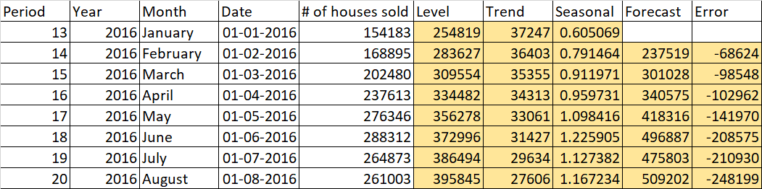

Slide 48
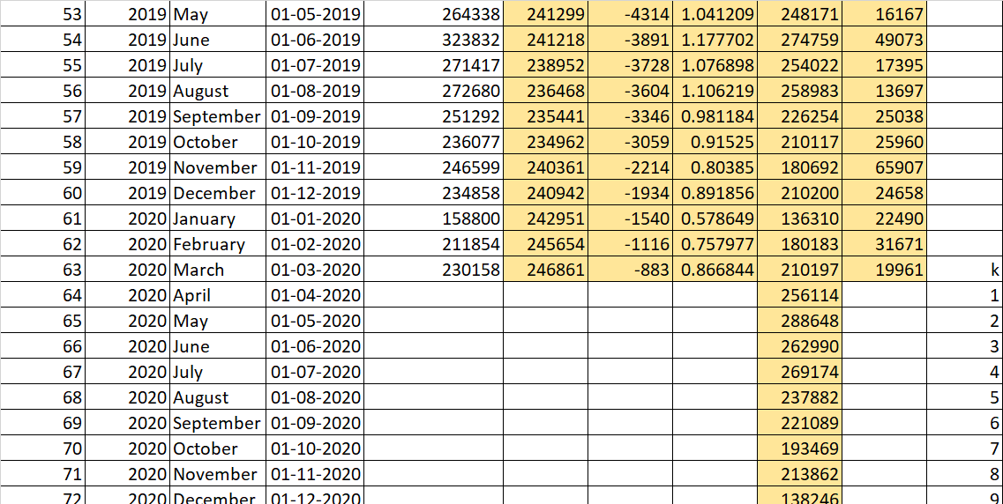

Slide 49
Period | Year |  | Date | # of | houses sold | Level | Trend | Seasonal
1 |  | 2015 | 01-01-2015 |  | 131646 | S1 |  | 0.605069
2 |  | 2015 | 01-02-2015 |  | 176938 | S2 |  | 0.81324
3 |  | 2015 | 01-03-2015 |  | 204653 | S3 |  | 0.940623
4 |  | 2015 | 01-04-2015 |  | 214838 | S4 |  | 0.987435
5 |  | 2015 | 01-05-2015 |  | 246787 | S5 |  | 1.134279
6 |  | 2015 | 01-06-2015 |  | 277672 | S6 |  | 1.276232
7 |  | 2015 | 01-07-2015 |  | 255973 | S7 |  | 1.176499
8 |  | 2015 | 01-08-2015 |  | 266235 | S8 |  | 1.223665 | α | 0.1
9 |  | 2015 | 01-09-2015 |  | 230914 | S9 |  | 1.061323 | β | 0.1
10 |  | 2015 | 01-10-2015 |  | 213793 | S10 |  | 0.982632 | γ | 0.1
11 |  | 2015 | 01-11-2015 |  | 180825 | S11 |  | 0.831105
12 |  | 2015 | 01-12-2015 |  | 210587 | S12 |  | 0.967897 | Forecast | Error
13 |  | 2016 | 01-01-2016 |  | 154183 | 254819 | 37247 | 0.605069
14 |  | 2016 | 01-02-2016 |  | 168895 | 283627 | 36403 | 0.791464 | 237519 | -68624
15 |  | 2016 | 01-03-2016 |  | 202480 | 309554 | 35355 | 0.911971 | 301028 | -98548
16 |  | 2016 | 01-04-2016 |  | 237613 | 334482 | 34313 | 0.959731 | 340575 | -102962
17 |  | 2016 | 01-05-2016 |  | 276346 | 356278 | 33061 | 1.098416 | 418316 | -141970
18 |  | 2016 | 01-06-2016 |  | 288312 | 372996 | 31427 | 1.225905 | 496887 | -208575
19 |  | 2016 | 01-07-2016 |  | 264873 | 386494 | 29634 | 1.127382 | 475803 | -210930
20 |  | 2016 | 01-08-2016 |  | 261003 | 395845 | 27606 | 1.167234 | 509202 | -248199
21 |  | 2016 | 01-09-2016 |  | 235482 | 403293 | 25590 | 1.013581 | 449418 | -213936
22 |  | 2016 | 01-10-2016 |  | 238741 | 410291 | 23731 | 0.942557 | 421434 | -182693
23 |  | 2016 | 01-11-2016 |  | 210884 | 415993 | 21928 | 0.798689 | 360717 | -149833
24 |  | 2016 | 01-12-2016 |  | 200432 | 414837 | 19619 | 0.919423 | 423862 | -223430
25 |  | 2017 | 01-01-2017 |  | 162196 | 417817 | 17955 | 0.583382 | 262876 | -100680
26 |  | 2017 | 01-02-2017 |  | 193105 | 416594 | 16038 | 0.758671 | 344898 | -151793
27 |  | 2017 | 01-03-2017 |  | 217340 | 413200 | 14094 | 0.873373 | 394547 | -177207
28 |  | 2017 | 01-04-2017 |  | 267999 | 412489 | 12614 | 0.928729 | 410088 | -142089
29 |  | 2017 | 01-05-2017 |  | 275747 | 407697 | 10873 | 1.056209 | 466940 | -191193
30 |  | 2017 | 01-06-2017 |  | 293088 | 400621 | 9078 | 1.176473 | 513127 | -220039
31 |  | 2017 | 01-07-2017 |  | 276851 | 393287 | 7437 | 1.085038 | 461888 | -185037
32 |  | 2017 | 01-08-2017 |  | 266860 | 383514 | 5716 | 1.120094 | 467739 | -200879
33 |  | 2017 | 01-09-2017 |  | 240859 | 374070 | 4200 | 0.976612 | 394516 | -153657
34 |  | 2017 | 01-10-2017 |  | 235874 | 365468 | 2920 | 0.912842 | 356541 | -120667
35 |  | 2017 | 01-11-2017 |  | 218218 | 358871 | 1968 | 0.779627 | 294227 | -76009
36 |  | 2017 | 01-12-2017 |  | 209316 | 347522 | 636 | 0.887712 | 331764 | -122448
37 |  | 2018 | 01-01-2018 |  | 155722 | 340035 | -176 | 0.57084 | 203109 | -47387
38 |  | 2018 | 01-02-2018 |  | 197765 | 331941 | -968 | 0.742382 | 257842 | -60077
39 |  | 2018 | 01-03-2018 |  | 224567 | 323588 | -1706 | 0.855435 | 289063 | -64496
40 |  | 2018 | 01-04-2018 |  | 252527 | 316885 | -2206 | 0.915547 | 298941 | -46414
41 |  | 2018 | 01-05-2018 |  | 260426 | 307868 | -2887 | 1.035179 | 332367 | -71941
42 |  | 2018 | 01-06-2018 |  | 301841 | 300139 | -3371 | 1.159393 | 358801 | -56960
43 |  | 2018 | 01-07-2018 |  | 274278 | 292369 | -3811 | 1.070346 | 322004 | -47726
44 |  | 2018 | 01-08-2018 |  | 263149 | 283196 | -4347 | 1.101006 | 323212 | -60063
45 |  | 2018 | 01-09-2018 |  | 256927 | 277272 | -4505 | 0.971613 | 272327 | -15400
46 |  | 2018 | 01-10-2018 |  | 226363 | 270288 | -4753 | 0.905306 | 248993 | -22630
47 |  | 2018 | 01-11-2018 |  | 205678 | 265363 | -4770 | 0.779172 | 207018 | -1340
48 |  | 2018 | 01-12-2018 |  | 216753 | 258951 | -4934 | 0.882645 | 231331 | -14578
49 |  | 2019 | 01-01-2019 |  | 143530 | 253758 | -4960 | 0.570318 | 145003 | -1473
50 |  | 2019 | 01-02-2019 |  | 195802 | 250293 | -4811 | 0.746373 | 184703 | 11099
51 |  | 2019 | 01-03-2019 |  | 221326 | 246807 | -4678 | 0.859567 | 209994 | 11332
52 |  | 2019 | 01-04-2019 |  | 240711 | 244208 | -4470 | 0.92256 | 221680 | 19031
53 |  | 2019 | 01-05-2019 |  | 264338 | 241299 | -4314 | 1.041209 | 248171 | 16167
54 |  | 2019 | 01-06-2019 |  | 323832 | 241218 | -3891 | 1.177702 | 274759 | 49073
55 |  | 2019 | 01-07-2019 |  | 271417 | 238952 | -3728 | 1.076898 | 254022 | 17395
56 |  | 2019 | 01-08-2019 |  | 272680 | 236468 | -3604 | 1.106219 | 258983 | 13697
57 |  | 2019 | 01-09-2019 |  | 251292 | 235441 | -3346 | 0.981184 | 226254 | 25038
58 |  | 2019 | 01-10-2019 |  | 236077 | 234962 | -3059 | 0.91525 | 210117 | 25960
59 |  | 2019 | 01-11-2019 |  | 246599 | 240361 | -2214 | 0.80385 | 180692 | 65907
60 |  | 2019 | 01-12-2019 |  | 234858 | 240942 | -1934 | 0.891856 | 210200 | 24658
61 |  | 2020 | 01-01-2020 |  | 158800 | 242951 | -1540 | 0.578649 | 136310 | 22490
62 |  | 2020 | 01-02-2020 |  | 211854 | 245654 | -1116 | 0.757977 | 180183 | 31671
63 |  | 2020 | 01-03-2020 |  | 230158 | 246861 | -883 | 0.866844 | 210197 | 19961 | k
Month January February March April
May June July August
September October November December January February March
April May June July August
September October November December January February March
April May June July August
September October November December January February March
April May June July August
September October November December January February March
April May June July August
September October November December January February March

Slide 50
Statistical Methods for Data Science
Time Series Holts-Winters Triple Exponential Smoothing
Trend | Seasonality
 | No | Linear | Ratio
No
Linear
Ratio

Slide 51
Statistical Methods for Data Science
Time Series Smoothing Techniques – Exponential
No seasonality
No trend

Slide 52
Statistical Methods for Data Science
Time Series Smoothing Techniques – Exponential
Linear seasonality
No trend

Slide 53
Statistical Methods for Data Science
Time Series Smoothing Techniques – Exponential
Ratio seasonality
No trend

Slide 54
Statistical Methods for Data Science
Time Series Smoothing Techniques – Exponential
No seasonality
Linear trend

Slide 55
Statistical Methods for Data Science
Time Series Smoothing Techniques – Exponential
Linear seasonality
Linear trend

Slide 56
Statistical Methods for Data Science
Time Series Smoothing Techniques – Exponential
Ratio seasonality
Linear trend

Slide 57
Statistical Methods for Data Science
Time Series Smoothing Techniques – Exponential
No seasonality
Ratio trend

Slide 58
Statistical Methods for Data Science
Time Series Smoothing Techniques – Exponential
Linear seasonality
Ratio trend

Slide 59
Statistical Methods for Data Science
Time Series Smoothing Techniques – Exponential
Ratio seasonality
Ratio trend

Slide 60
Statistical Methods for Data Science
Time Series Measurement of forecast error
What was forecasted
to happen at time t using the forecast technique
Forecast Error
at time t
Δ _{t} = Y_{t} - F_{t}
What actually happened
at time t

Slide 61
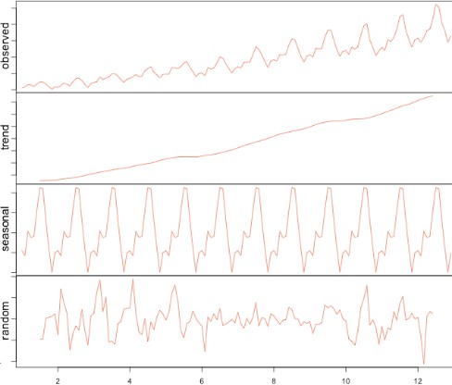
Statistical Methods for Data Science
Time Series Decomposition view

Slide 62
